Slide 1
Understanding our patients
Shannon Knight
ironhack project 1

Slide 2
TABLE OF CONTENTS
01.
Project overview
02.
Data cleaning
03.
EDA
04.
Major obstacles
05.
Project management
06.
Conclusion
How many patients? And what is their risk profile?
The usual + anonymisation
Counts and risk profiling
Dates, nulls, correlations
Trello
Age is a good proxy for patient risk

Slide 3
Project overview
Business problem: resource planning for a managed care organisation that is responsible for primary care services
How many patients under our care? And what is their risk profile?
Data = (1) demographic data on patients (135k) + (2) GPs in program
Hypothesis 1: there are approx 80k patients under our care and not 135k
Hypothesis 2: age data can be used as a proxy for risk
Data cleaning:
Join datasets and exclude patients not in program
Sort out dates and null values
Anonymise data

Slide 4
Data cleaning
Merging data
Null values
Anonymisation
Remove columns from patient data
Merge with GP data (left join)
Remove rows for patients with GPs not in the program
135k -> 80k rows
61 -> 28 columns
Objects -> “not known”
Dates -> 0
Other: chronic count & length of stay -> 0
Patient and GP identifiers
Defined function to swap numbers for letters

Slide 5
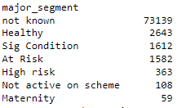
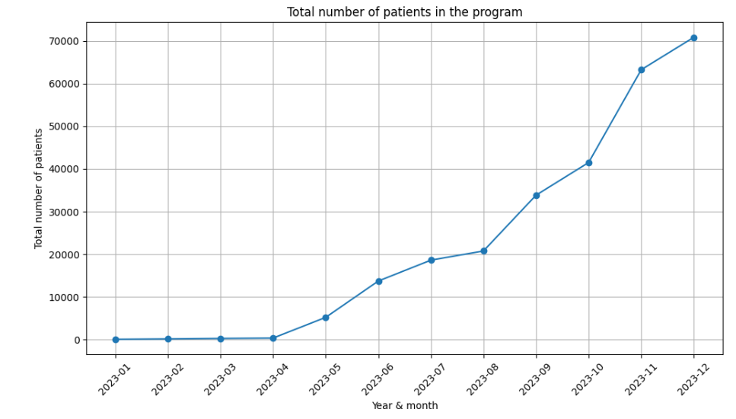
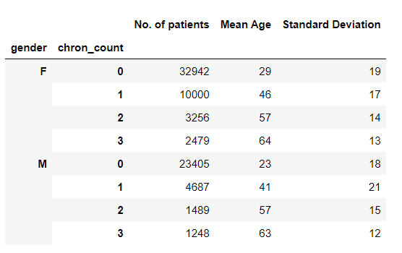
EDA - patient numbers and risk profile

Slide 6
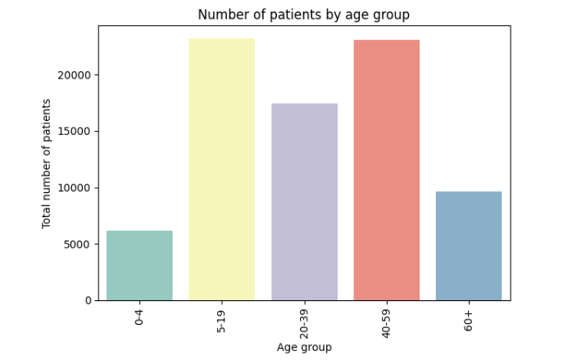
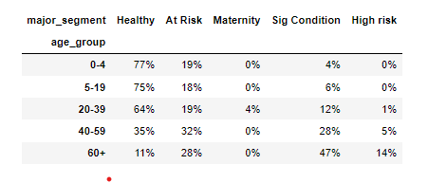
EDA - age as a proxy for risk profile
n=6k
Measures the strength and direction of association between two ranked variables

Slide 7
Major obstacles
Dealing with confidential data:
Original data included patient identifiers and GP names which needed to be anonymised
I did a significant amount of cleaning before anonymising - issues then with what to share/save on github
Should have anonymised as step 1 and then carried on with the cleaning
Dates issues:
Original data from excel had multiple date columns stored as a “general” format
Struggled to use pandas.to_datetime function to fix these
Changed format in original data which solved the issue
Dates are a challenge - good to be able to work with the dev team to develop standards

Slide 8
Project management
Tuesday
Thursday
Data cleaning + EDA
Finalise analysis + build presentation
02
04
01
03
05
Monday
Wednesday
Friday
Git + Github
Planning
Data extraction
EDA + Correlation analysis
Today

Slide 9
Conclusions
Implications
Further research
 |  |  |  |  | Accept | Reject
Hypothesis 1: there are approx 80k patients under our care and not 135k
Hypothesis 2: age data can be used as a proxy for risk
The number of Allied Healthcare Professionals can now be determined based on (a) number of patients (b) their risk profile
Model to translate age into risk segment
Resource planning by geographical area

Slide 10
Thank you!

